Slide 1

AMCS1003 Software engineering
Group 4 : Logistics System
By Tan Kang Hong, Lau Jun Dian, Har Chun Wai,
Cheng Cai Jie & Nee Mei Yi

Slide 2

CEO
Har Chun Wai
CFO
Lau Jun Dian
Graphic Designer
Nee Mei Yi
Programmer
Tan Kang Hong
Marketing Manager
Cheng Cai Jie

Slide 3

PART 3

Slide 4
Table of contents Part 3 3.1 Good user interface design principles 3.2 Test cases 3.3 Software Maintenance

Slide 5
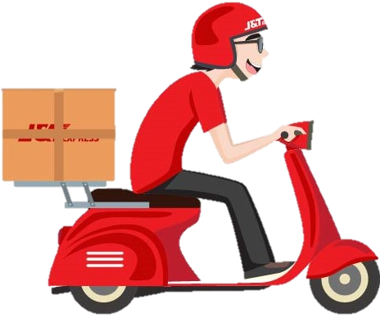
3.1 Good user interface
design principles

Slide 6
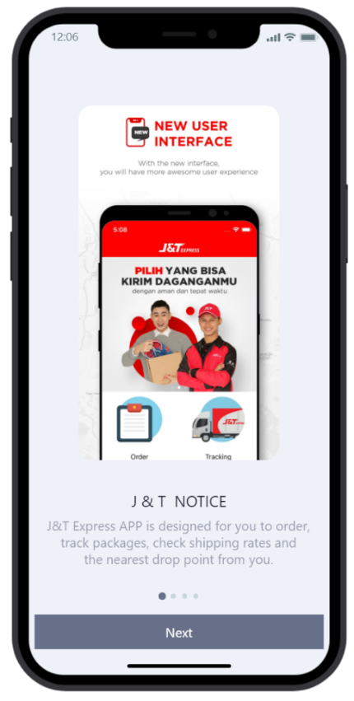
1. The UI design must be clarity and be easy to understand.

Slide 7
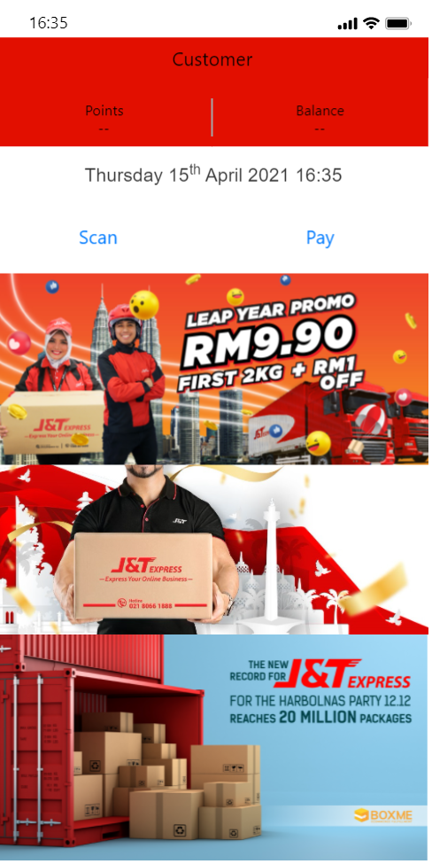
2. The UI design must be emotionally pleasing to look at.

Slide 8
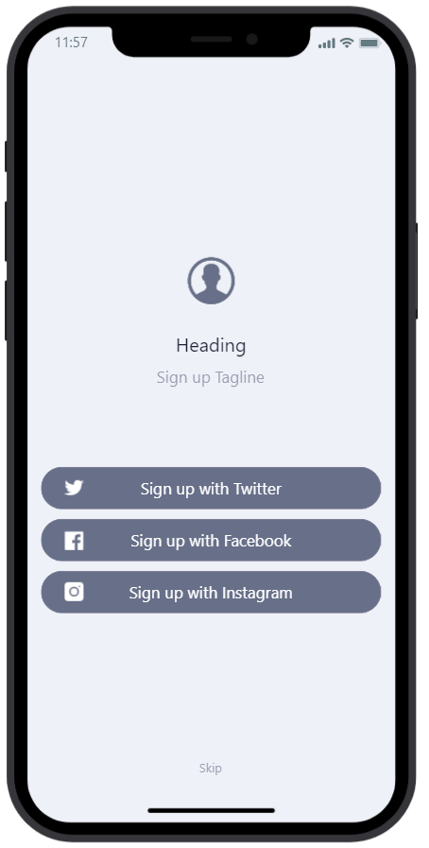
3. UI design also need to consistent throughout the site. 4. User can easy to control of the interface.

Slide 9
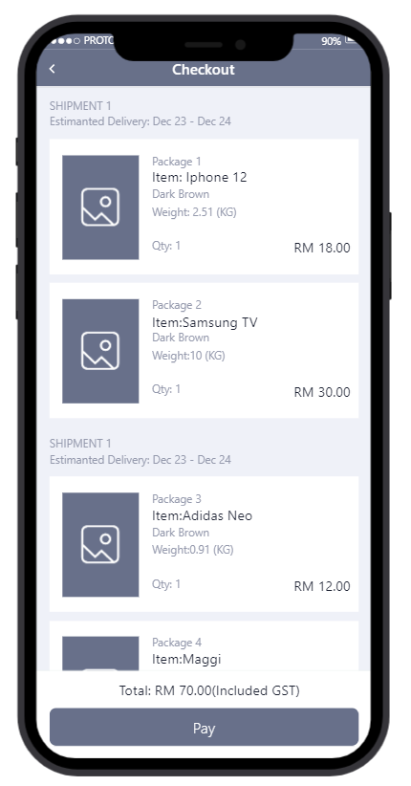
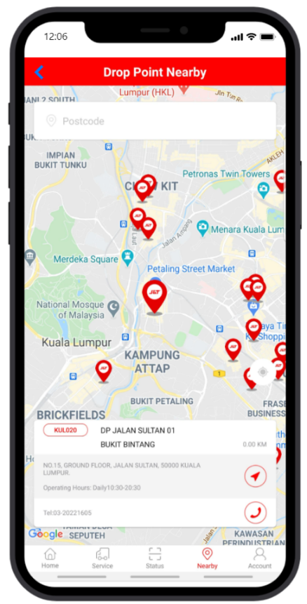
5. UI design should match between system and the real world.

Slide 10
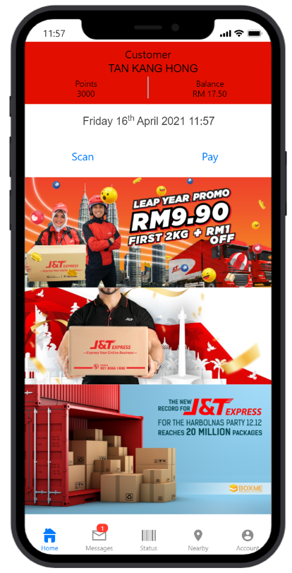
6. UI design need to reduce cognitive load.

Slide 11
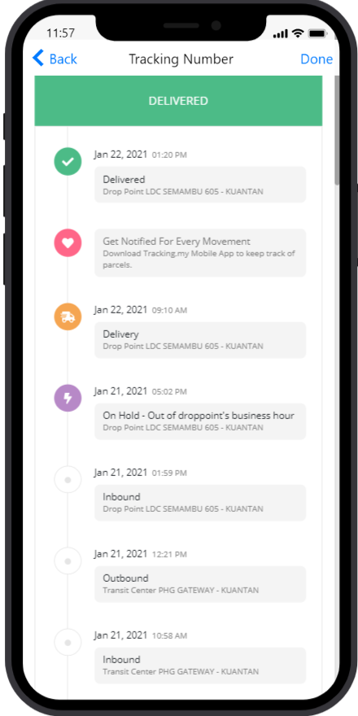
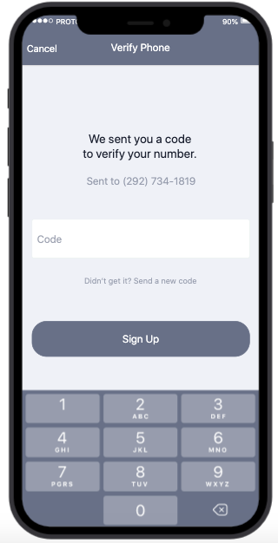
7. UI design should prevent error from appearing.

Slide 12
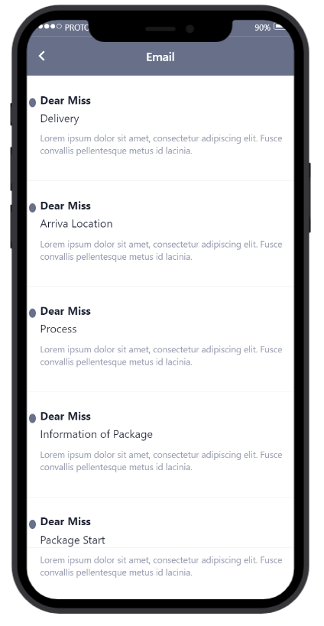
8. UI design also need to test the flexibility and efficiency of use.

Slide 13
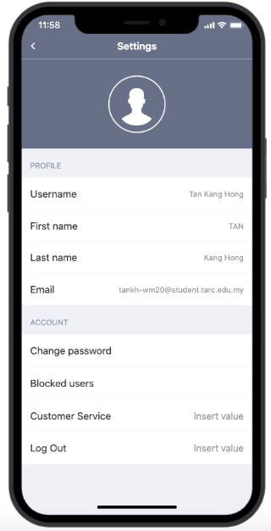
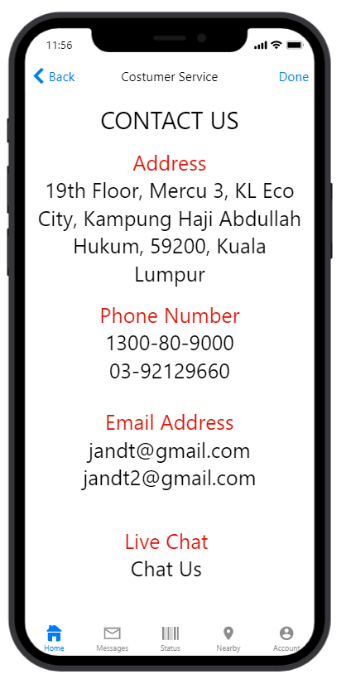
9. UI design need to provide help and documentation.

Slide 14

10. UI design should cover user families.

Slide 15
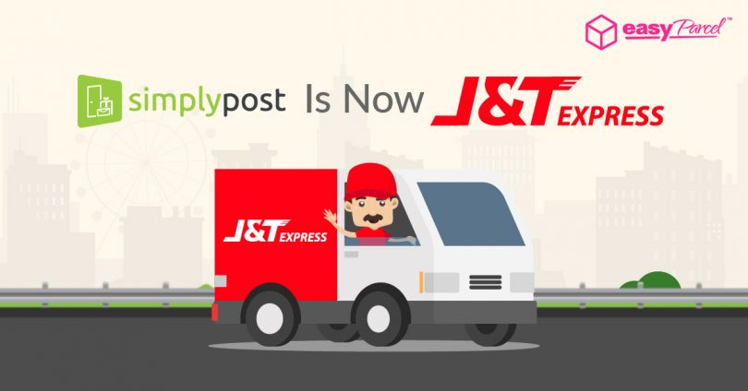
3.2 Test cases

Slide 16
Login (Sign up with Twitter, E-mail or Facebook)
Test Scenario: An automated system for checking login verification. A user is required to login with their account in order to access member-only contents in a website. When the user wants to login, the system has to verify the user is able to login with email and password. Based on this, a message will display by the system whether the user has successfully logged in or not.
Program Name: Login Validation Prepared by: Tan Kang Hong, Har Chun Wai, Lau Jun Dian Test Date: 01/04/2021 Tester: Cheng Cai Jie and Nee Mei Yi
No | Objective/Test Cases | Test Data | Expected Results | Actual Results | Remarks/Comments
1 | To display error message | Valid password but invalid email | Error message due to invalid email. | - | -
2 | To display error message | Valid email but invalid password | Error message due to invalid password. | - | -
3 | To display message user has successfully logged in | Valid email and valid password | Message user has successfully logged in | - | -
4 | Verify the ‘Remember Me’ functionality | Valid email and password then save it when the user is logged in. | The account will not be logged out automatically for a few days. | - | -
5 | Skip function | Press skip | The users will be redirected to the main page without logging in | - | -
6 | Forgot password function | Press Forgot password | The users will need to verify by system then just can change password. | - | -

Slide 17
2. Tracking number
Test Scenario: A parcel tracking system to allow users to check their parcel status. The user will search their parcel by typing the tracking number. Based on this system, user can know their parcel movement anytime.
Program Name: Parcel tracking Prepared by: Tan Kang Hong, Har Chun Wai, Lau Jun Dian Test Date: 01/04/2021 Tester: Cheng Cai Jie and Nee Mei Yi
No | Objective / Test Cases | Test Data | Expected Results | Actual Results | Remarks/Comments
1 | Search tracking number | Valid tracking number | Show customers real-time tracking of their parcels | - | -
2 | Get notified for every movement | Click Get notified for every movement | Customers will get notifications when their parcel is arrived | - | -
3 | To display error message | Invalid tracking number | Error message due to invalid tracking number | - | -

Slide 18
3. Payment
Test Scenario: A payment system for customers to make their payment. When the customer making the payment will has to verify the payment with the verification code to complete the payment.
Program Name: Payment system Prepared by: Tan Kang Hong, Har Chun Wai, Lau Jun Dian Test Date: 01/04/2021 Tester: Cheng Cai Jie and Nee Mei Yi
No | Objective / Test Cases | Test Data | Expected Results | Actual Results | Remarks / Comments
1 | Checking package | Valid order package | Show customer whether the package correctly | - | -
2 | Payment verification | Valid the verification code to payment | Show customer the security code can protect our customer during payment process | - | -
3 | Display estimate delivery date | Valid to know arrive location time | Show customer the package of date will be arrive location | - | -
4 | Cancel payment | Valid order package, and confirmation by customer to cancel payment | Show message that the payment has been successfully cancelled | - | -
5 | Receipt | Valid order package and payment is confirmed | Show customer the receipt to claim the points of J&T Express. | - | -
6 | Point | Valid payments | Customers will get points after their payment has been confirmed. | - | -

Slide 19
4. Main page
Test Scenario: Display the main page for the J&T Express app.
Program Name: Main page Prepared by: Tan Kang Hong, Har Chun Wai, Lau Jun Dian Test Date: 01/04/2021 Tester: Cheng Cai Jie and Nee Mei Yi
No | Objective / Test Cases | Test Data | Expected Results | Actual Results | Remarks/Comments
1 | Display customer balance | Valid balance | Let customer know their balance left and get reminder from J&T Express when the balance is low | - | -
2 | Display promotions | Valid promotion | Display current promotions so customers can enjoy low shipping price. | - | -
3 | Display email | Valid email | Display the customer’s email in the account page. | - | -
4 | Click payment | Valid payment | Display the checkout screen when the customer wants to make payment | - | -
5 | Display tracking number screen | Valid tracking number | Show customers real-time tracking of their parcels | - | -
6 | Display location screen | Valid location | Show where the branch nearby customer and display all the information of the branch

Slide 20
5. Setting
Test Scenario: An automated system for testing every function inside setting. The user is required to check the account information, customer service and other function that are inside the setting page. Based on this, user can know more detail about account information.
Program Name: Setting Prepared by: Tan Kang Hong, Har Chun Wai, Lau Jun Dian Test Date: 01/04/2021 Tester: Cheng Cai Jie and Nee Mei Yi
No | Objective / Test Cases | Test Data | Expected Results | Actual Results | Remarks / Comments
1 | Display account information | Account information screen | Show customer all the information details | - | -
2 | Log out | Log out button | The customer will be prompted into the log in screen. | - | -
3 | Change password | Change password button | Let customer change their password | - | -
4 | Block user | Block user button | Display blocked delivery staffs where the staff cannot make deliver parcels to the customer in future deliveries. | - | -
5 | Customer Service | Customer service screen | Show all the company information to customer and display the email address to let customer give some feedback. | - | -

Slide 21
3.3 Software Maintenance

Slide 22
Corrective maintenance
The execution of maintenance tasks to identify, isolate and correct faults.
Example, the maintenance is lifted to fix all the system errors that reported by customers, such as unable to place their order due to technical problems.

Slide 23
Adaptive maintenance
-The system will be modified and updated in terms of its design when the customer needs the system to run on a new environment.
-For example, the maintenance will be lifted when customer need a new user interface design in the mobile app due to an outdated design.

Slide 24
Perfective maintenance
-The system will follow customer’s feedback to improve it from time to time.
-For example, customers need a better data input in the “Create Input” screen.

Slide 25
Preventive maintenance
-The maintenance may also be lifted to prevent future problems of the software and reduce the chance of failure.
-Preventive maintenance may also reduce the security risks of employees and customers.

Slide 26

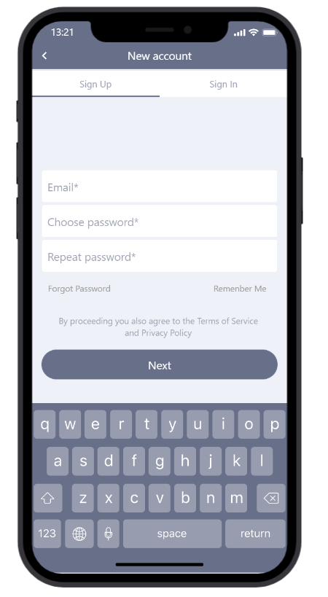
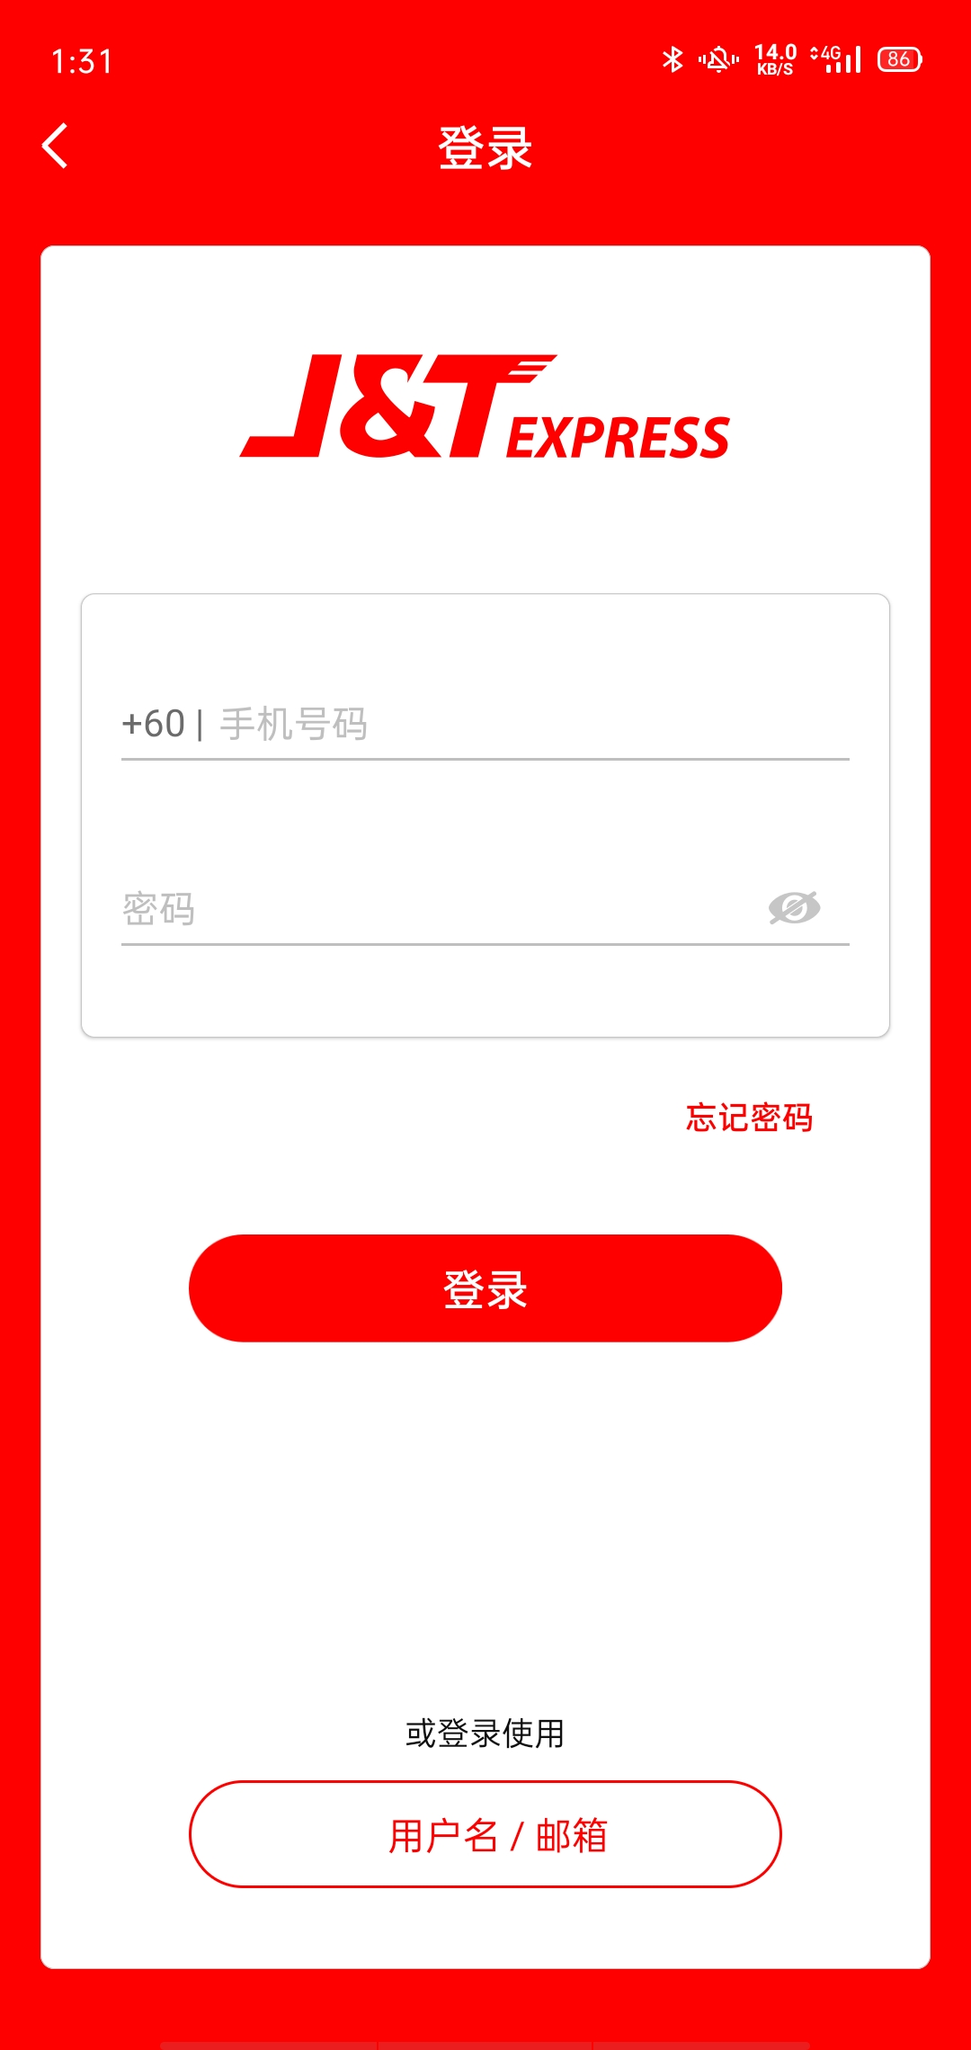
Additional Function
Login By US
We added most details information from customer and get some additional function.
Login By Real Company

Slide 27
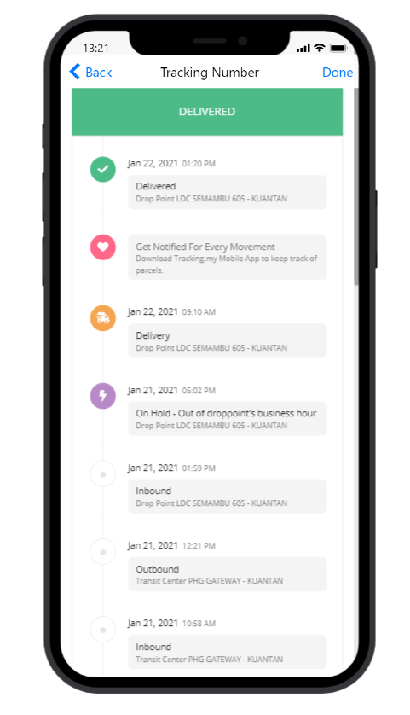
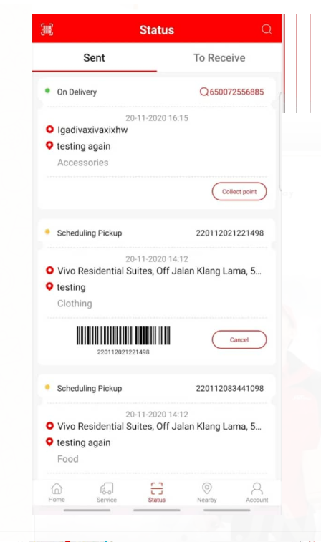
Additional Function
Tracking Number By US
We added most details information and contact to user
Tracking Number By Real Company

Slide 28
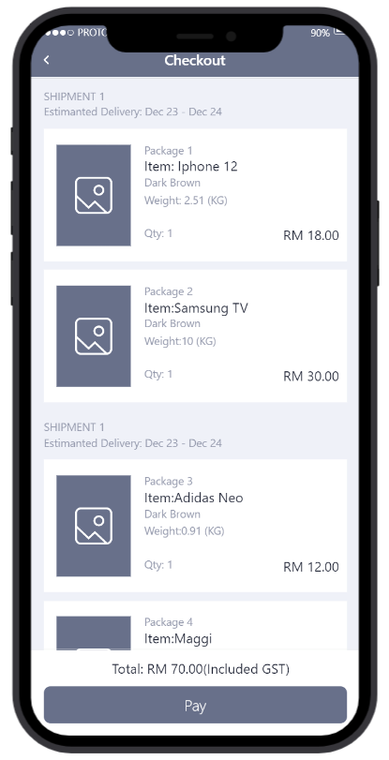
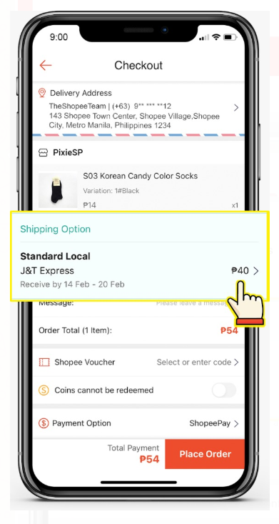
Additional Function
Payment By US
We added most details information about package and the shipping date.
Payment By Real Company

Slide 29
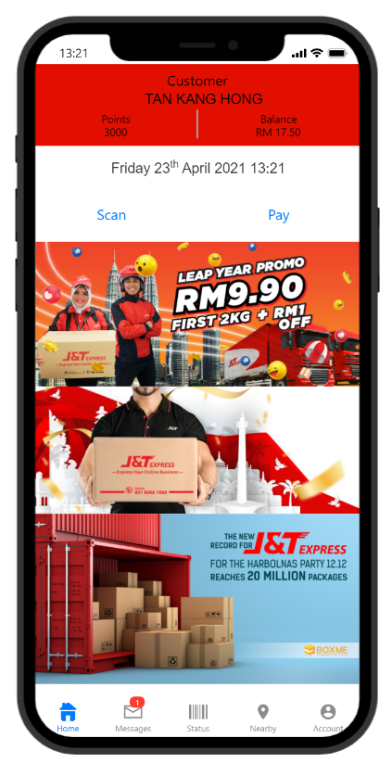
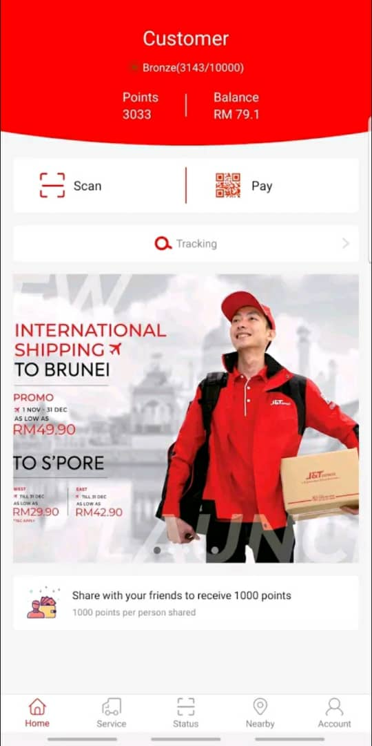
Additional Function
Main Menu By US
We added Email. Customer name and the messages.
Main Menu By Real Company

Slide 30
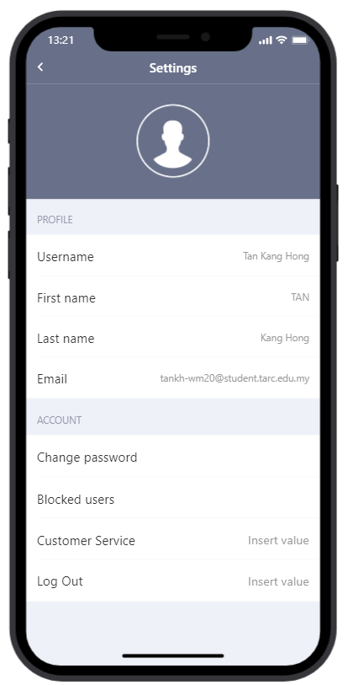
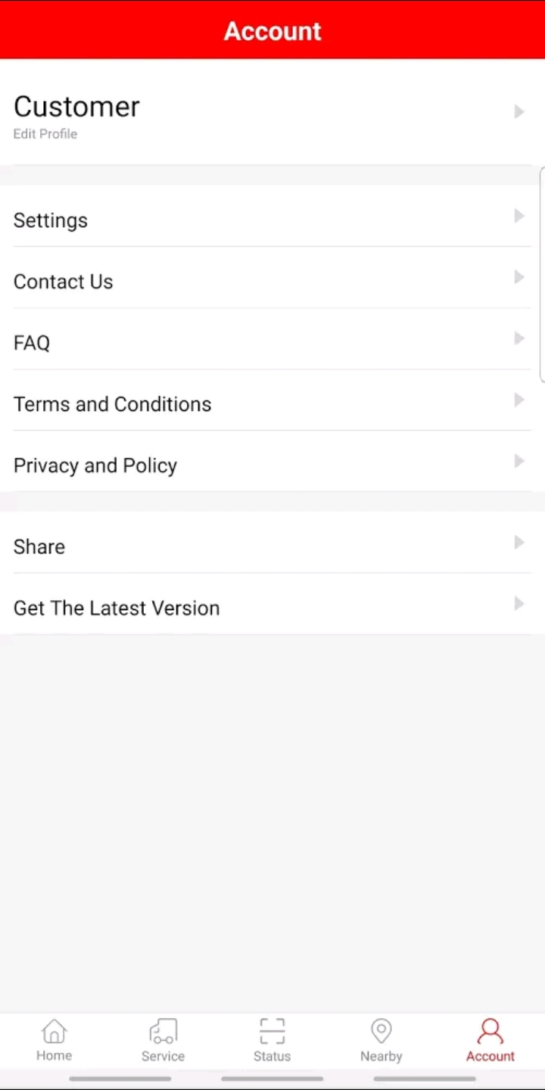
Additional Function
Settings By US
We added most details information from customer, we provide block user(deliver boy) and also provde customer service (24 hours).
Settings By Real Company

Slide 31
The end
Thank for listening

